Slide 1



ICTC Training program

Slide 2
Versioning
Version | Date of version | Author / Contributors | Modifications
2 | 2017-06-09 | Carol Andrea Guerrero Mickaël Brard Julien Jézéquel-Bréard | Diffusion initiale
CC-BY-NC-SA

Slide 3
Summing-up
Integrated Business Process with Odoo
Purchases
CRM
Suppliers
Manufacturing
Business Processes
Customers
Inventory
Sales
Human Resources
Accounting
Projects
Employees
CC-BY-NC-SA

Slide 4











Summing-up / ERP Modules
CRM
Sales
Purchases
Inventory
Sales team Management
Customer Management
Lead Management
Opportunities Management
Help Desk & Support
Quotation Management
Order Management
Invoice Management
Products & Pricing Management
Purchasing Management
Replenishment
Supplier Management
Products / Services Management
Inventory Management
Logistics – In & Out Bound
Stock Allocation
Warehouse & Locations Management
Manufacturing
Accounting
Projects
Human Resources
Production Order
Bill of Material
Routing
Quality & Maintenance
Lean Manufacturing
Account Receivables
Account Payables
Bank & Cash Management
Business Analytics
Set taxes
Cost Accounting
Budget & Forecast
Business Strategy
Ressource & Capacity Planning
Executive Dashboard & Control
Key Projects Metrics
Timesheet & Activity tracking
Expense Management
Recruitment
Employees
Performance Management
Compensation
Training & Development
Attendance & Leaves
Expenses
CC-BY-NC-SA

Slide 5
Human Resources Management

Slide 6
Outcomes
Business issues and the context of HR
Resourcing and talent management
Managing and coordinating the HR funtion
Reward management
Using information in HR for cross-sectional operations
CC-BY-NC-SA

Slide 7
Human Resources Strategies
HR Strategies
1. Planning Process
2. HR Process
3. Measuring
4. Action Plans
Strategic Business
Planning
HR Strategies & Plans
Workforce Planning
Salary Planning
Employment Law
Budget Unit
Individual Performance Goals
Program Scheduling &
Assignment
Monitoring & Control of Results
Available / Projected Resources
Organization & Job Design
Talent Acquisition
Performance Management
Training & Performance
Support
Payroll Management
Absence &Attendance
Management
Staffing Authorizations
Recruitment & Retention
Career Planning
Organizational Changes
Professional development
Compensation & Benefits
Labour Relations
Occupational Health & Safety
CC-BY-NC-SA
CC-BY-NC-SA

Slide 8







Human Resources
Track time spent on each job by employee
CC-BY-NC-SA

Slide 9
Human Resources
Create employee profiles
Manage contracts
Manage timesheets
Handle attendance
Manage leaves
Dashboards per manager
Manage
Enterprise Social Network
Chat in real time
Follow employees & documents
Join discussion groups
Share files
Gamification / Reward employees’ performance
Collaborate
Integration (Apps)
Recruitment
Appraisals
Expenses
Fleet
CC-BY-NC-SA

Slide 10
Employees Management

Slide 11
Employee Profile
In this module, you can manage employee information and centralize all RH information such as :
Creation of Departments
Creation Employee Profile
Public Information
Contact Information
Position (Job Title, Department, Manager, etc.)
Personal Information (Bank Account Number, Personal Address, Identification, Gender, Marital Status, etc.)
Appraisal
HR Settings (Timesheet Cost, Status within the company)
CC-BY-NC-SA

Slide 12
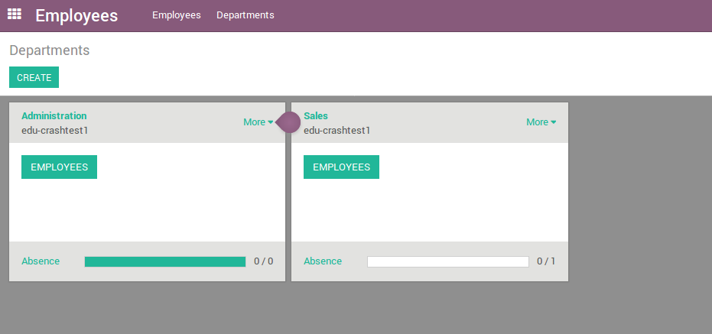
Employees
1
CC-BY-NC-SA

Slide 13
Exercise : Organizational structure
30 min
Administration
Operations
Finance
Tommy Hanks
Accounting
Maximo Smith
Sales
Marc Mars
Human Resources
Caroline Bonnet
Manufacturing
Christopher Neeson
Logistics
Philippe Mouchel
TO DO
Create the different departments of the company « Canadian Colors » in the system.
Create employee profiles for company managers. Invent the information that is necessary.
CC-BY-NC-SA

Slide 14
Recruitment Process

Slide 15
Workforce Planning
Workforce Needs
Environment Scan ( External Factors & Internal Supply)
Gather Data & Analysis Data
Analyse Supply Gaps
Identify workforce strategies & policies
Recruitment priorities
Monitor & Evaluate
CC-BY-NC-SA

Slide 16

Selection Process
6
1
Initial Entreview
Engagement
Incorporation
Monitoring
Needs analysis
Recruitment
Reception of applications
Preselection
Tests
2
7
3
8
4
9
5
CC-BY-NC-SA

Slide 17
Exercise : Manage the hiring process
15 min
As Human Resource Manager of Canadian Colors, you want to manage the whole hiring process at Odoo for a new job position « Junior Sales Consultant ».
TO DO
Use the module « Recruitment » and customize the steps of the recruitment process: pre-qualification, first interview, second interview, contract proposal.
Set up the new job position « Junior Sales Consultant »
Follow and build a database for an new applicant. Invent the information that is necessary.
CC-BY-NC-SA

Slide 18
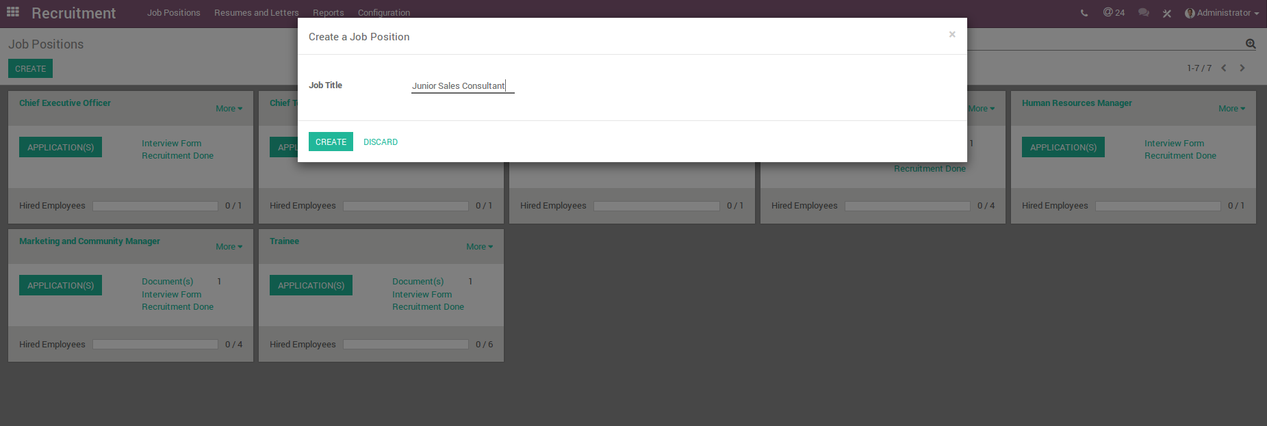
Hiring Process
CC-BY-NC-SA

Slide 19
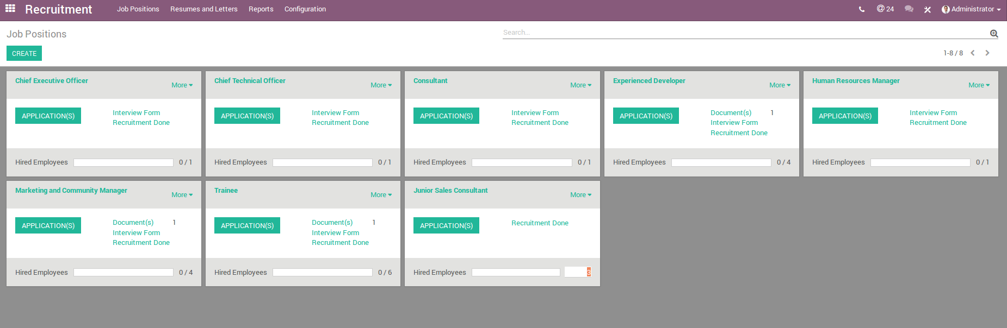
Hiring Process
# vacancies
CC-BY-NC-SA

Slide 20
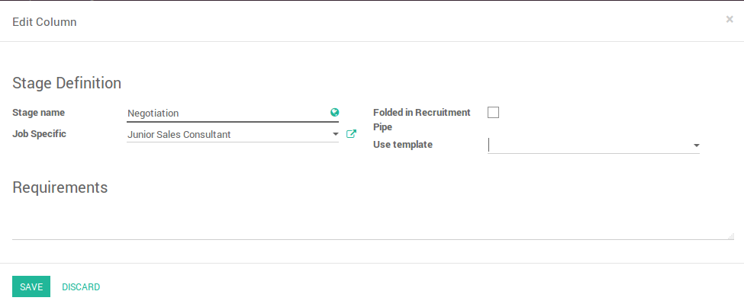
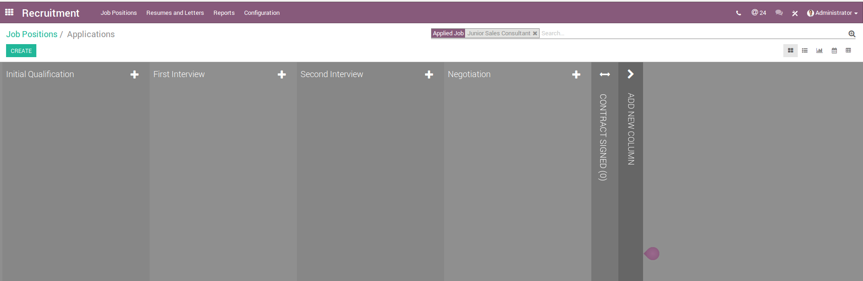
Steps of the recruitment process
CC-BY-NC-SA

Slide 21
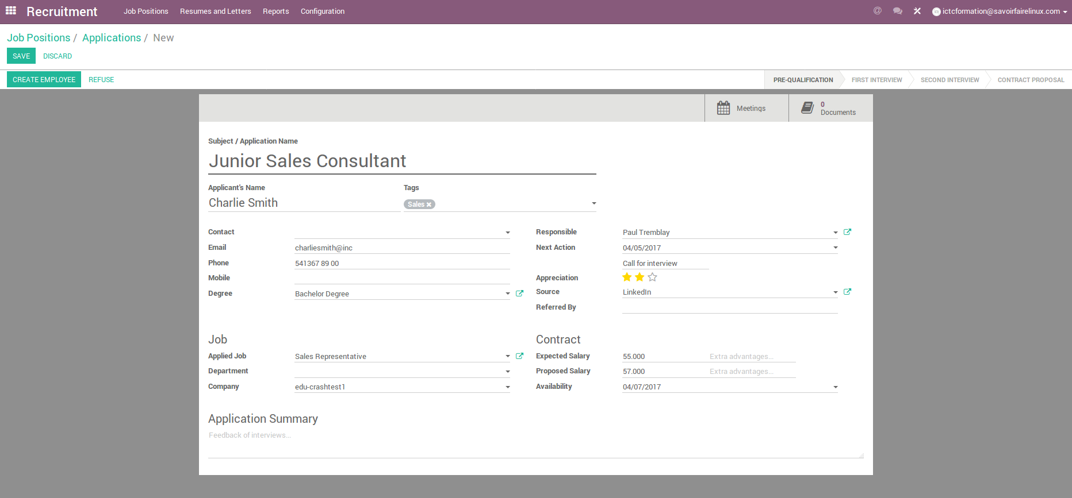
Candidate Applications
CC-BY-NC-SA

Slide 22
Exercise : Desing and scoring a job interview
60 min
In pairs, you will desing and score a job interview to the new job position « Junior Sales Consultant ».
To fully realize the effectiveness of your interview questions, design the questions so that they are based on the position requirements (education and experience, skills, working conditions, complexity of work, etc.)
TO DO
To develop effective interview questions, follow these steps :
1. Identify key job qualifications (eg. Conflict-resolution skills)
2. Develop an interview assessment for each question
Using the Survey Module in Odoo, create the job interview template that you have designed with your colleague.
CC-BY-NC-SA

Slide 23
Timesheets & Leaves

Slide 24
Timesheets & Leaves
These modules are digital documents, which allow summarizing hours worked by each worker during a pay period, and record employee attendance.
In detail these digital document or spreadsheets, workers can record the time of arrival and departure of workers, record the amount the time spent on each job, and track time & attendance for employees, specially for payroll purposes.
Track time spent on each job by employee
CC-BY-NC-SA

Slide 25









Integration with other Odoo Apps
Timesheets
Record time spend on each job by employee
+
Employee Profile
Update calendars automatically, and summary of time worked in a job
Attendance
Tracking for employee vacation and sick days
CC-BY-NC-SA

Slide 26
Exercise : Employee profile / Timesheets / Leaves
45 min
A new candidate is hired as a Junior Sales Consultant. These were his/her activities at the close of the first month of work:
- During the first three weeks, he/she completed 40 working hours each
- Last week, he/she was absent from his/her duties
- For the following month, he/she will be two days off work to attend a family activity
TO DO
Create the new employee profile. Invent the information that is necessary.
Record the total hours worked last month
As an employee request the days you will be out of work for the following month. This application will be approved by his/her superior
CC-BY-NC-SA

Slide 27
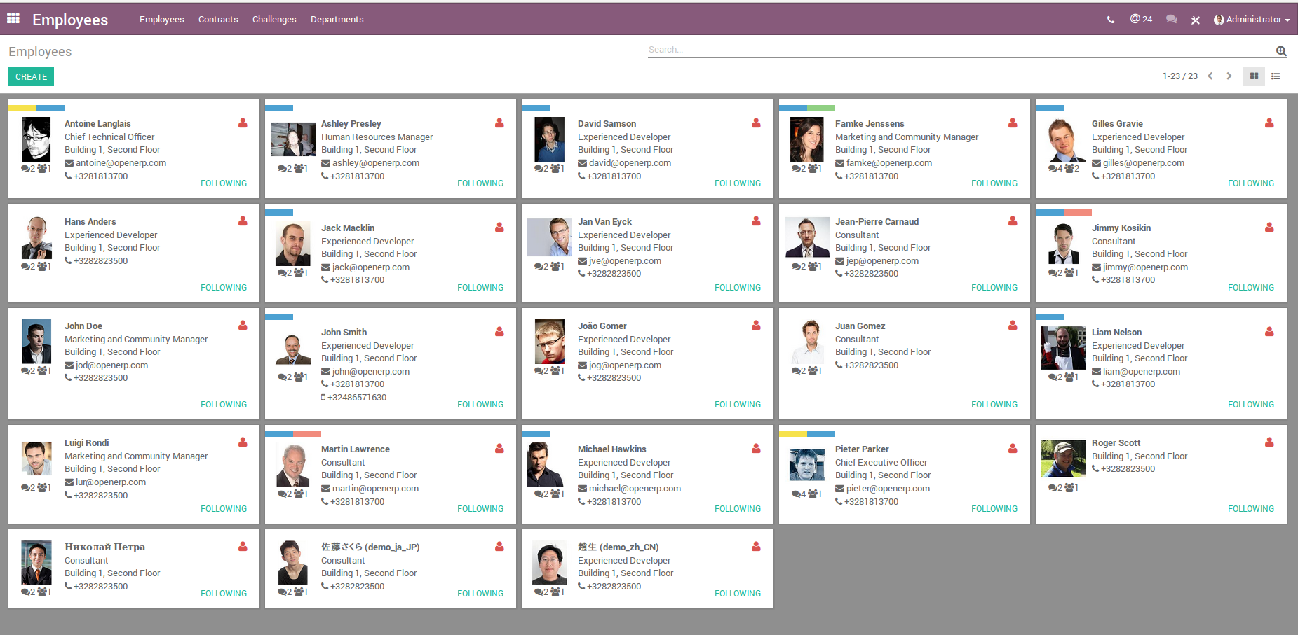
Employee Profile
CC-BY-NC-SA
CC-BY-NC-SA

Slide 28
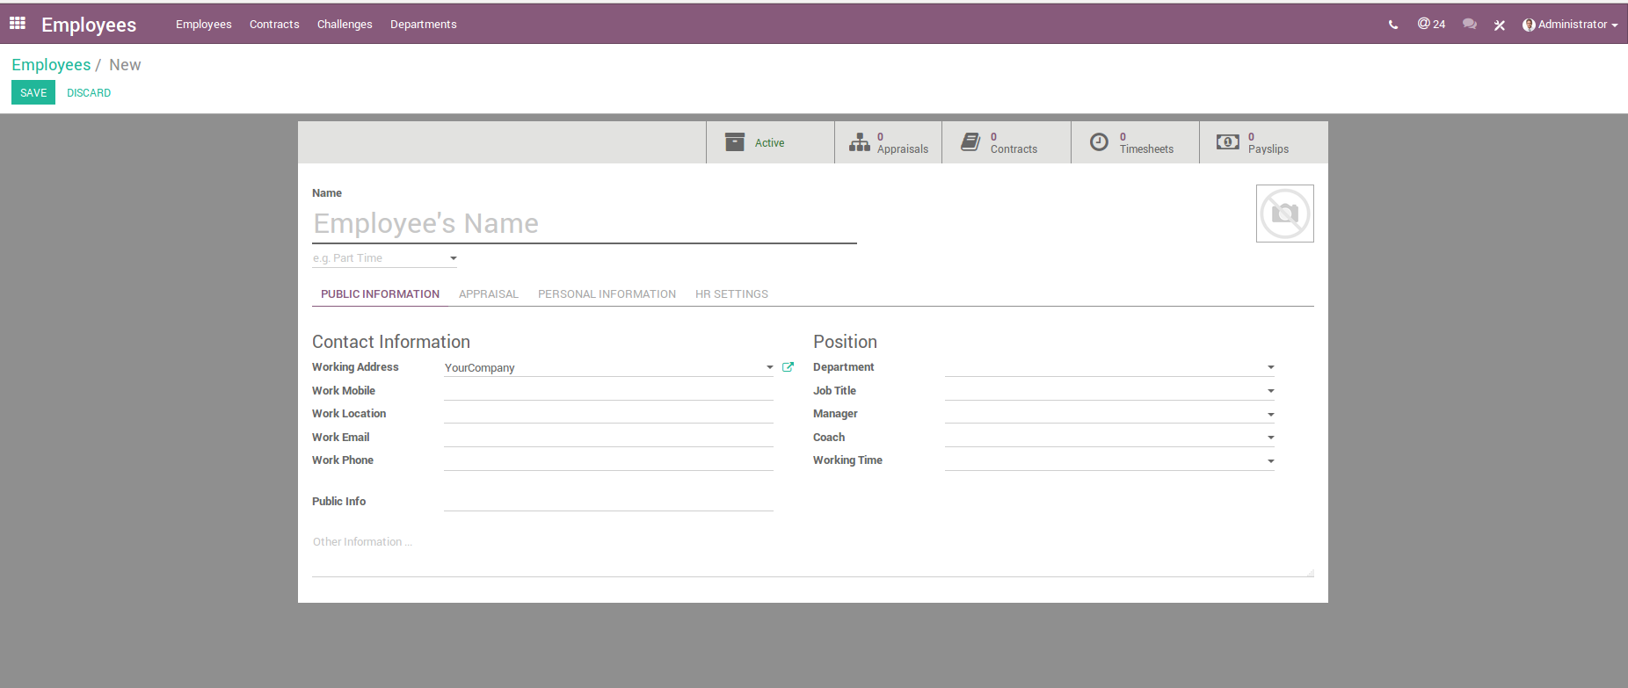
Employee Profile
CC-BY-NC-SA

Slide 29
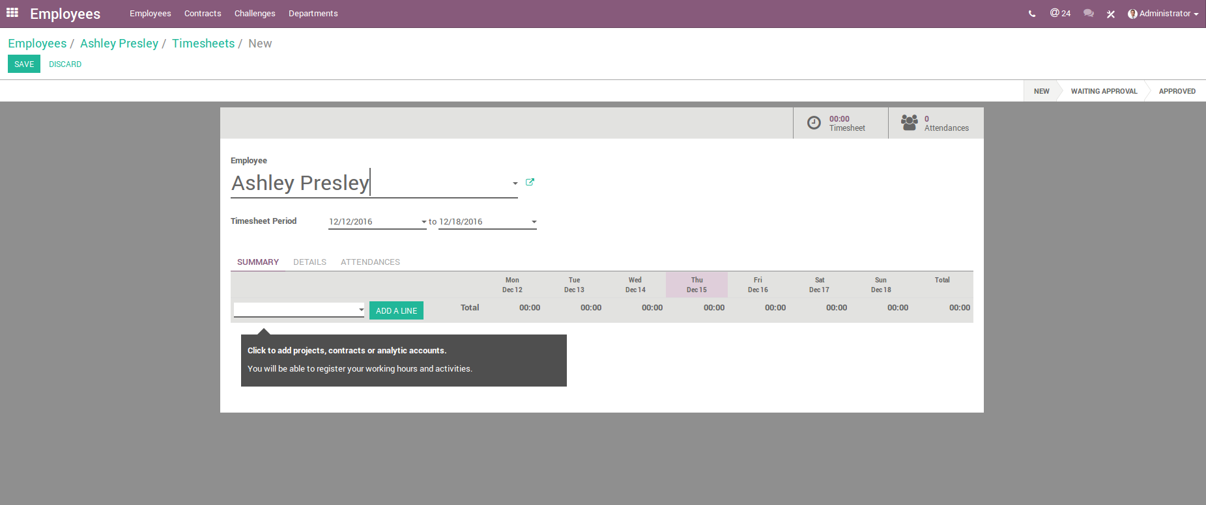
Timesheets
CC-BY-NC-SA

Slide 30
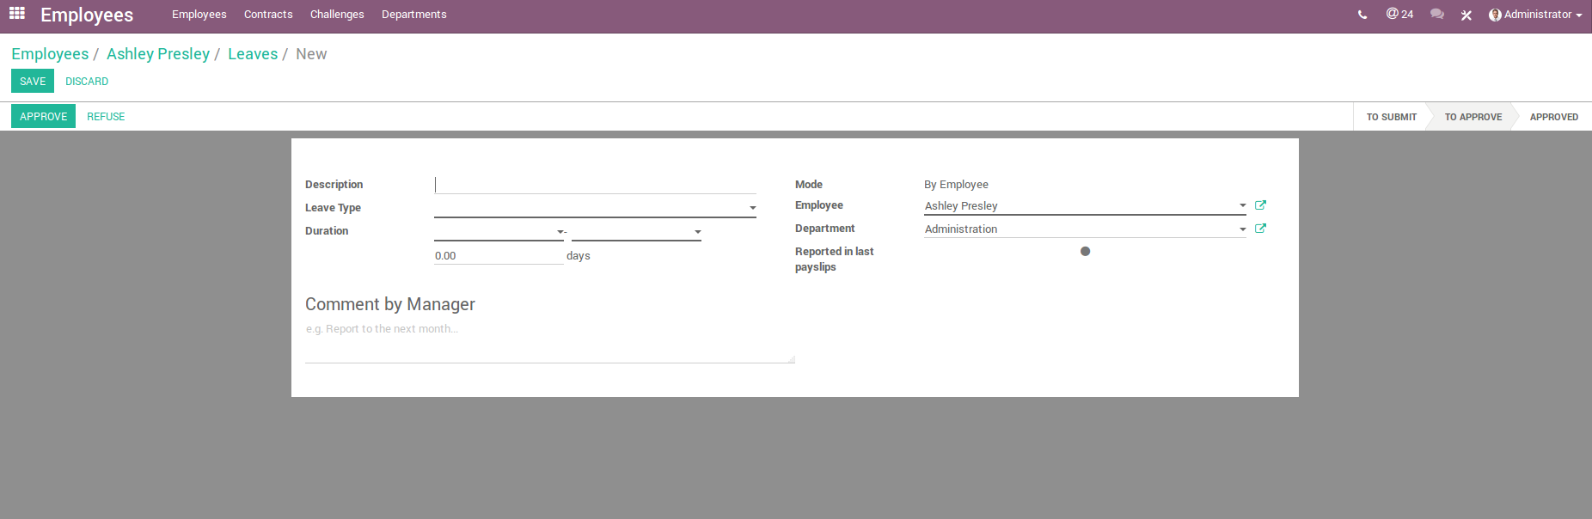
Attendance & Leaves
CC-BY-NC-SA

Slide 31
Employee Appraisals

Slide 32
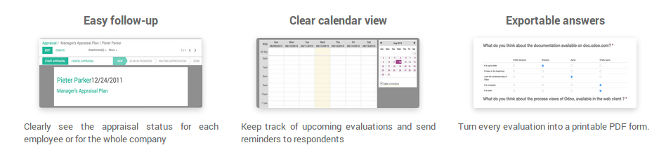
Employee Appraisals
Manage periodical employee evaluations of employees’ performance
Create appraisals and collect insightful information
Use templates or Employee Appraisals Form
Automate the evaluation process
CC-BY-NC-SA

Slide 33




Integration with other Odoo Apps
Appraisals
Manage empployee evaluations and create appraisals
CC-BY-NC-SA

Slide 34
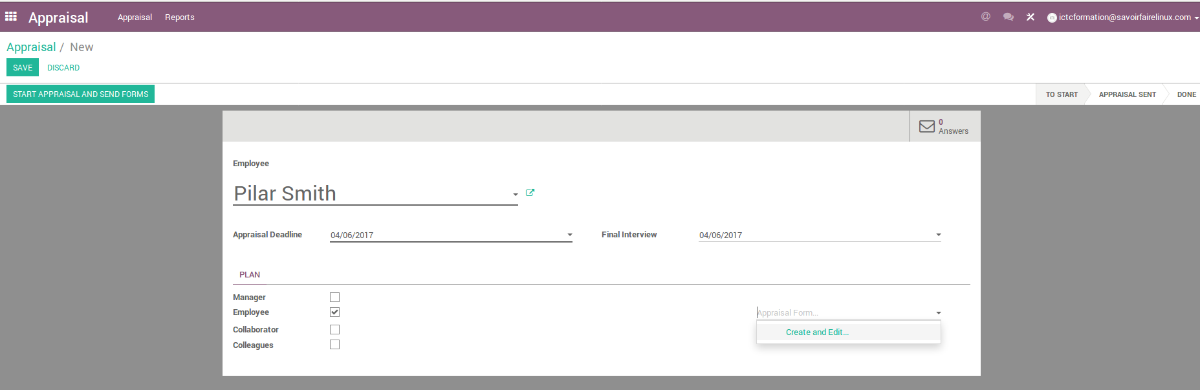
Set up appraisals
CC-BY-NC-SA

Slide 35
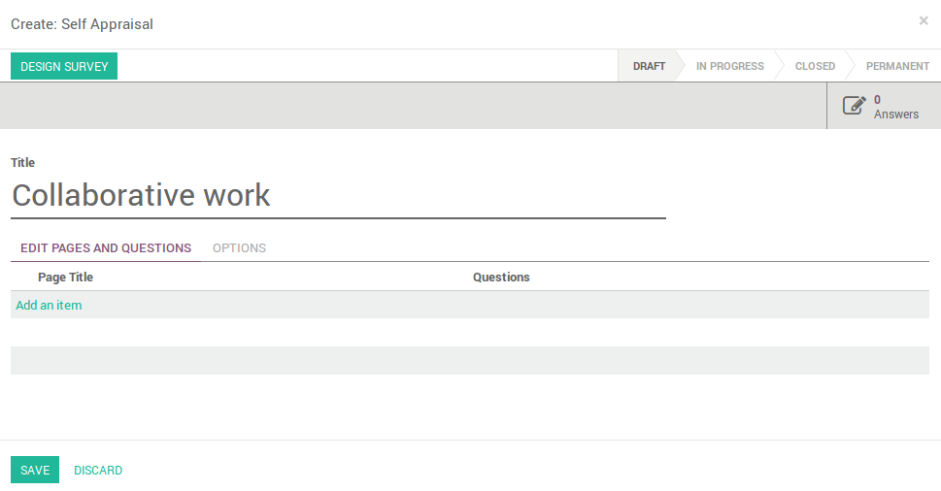
Set up appraisals
CC-BY-NC-SA

Slide 36
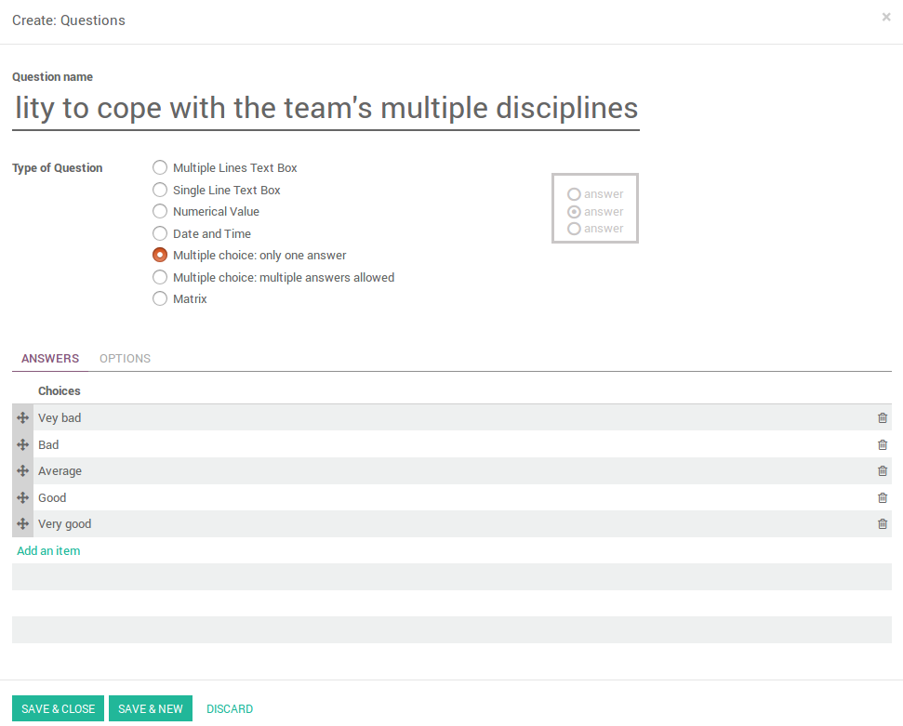
Set up appraisals
CC-BY-NC-SA

Slide 37
Exercise : Set up an appraisal
30 min
« Canadian Colors Inc » Human Resources wants to make a survey fo all employees to measure the working environment and teamwork between the different departments of the company. For that, you must design the survey and apply it to some employees :
TO DO
Create the survey taking the above information
Pick any employee created in the system and apply this survey
CC-BY-NC-SA

Slide 38
Expense Management

Slide 39
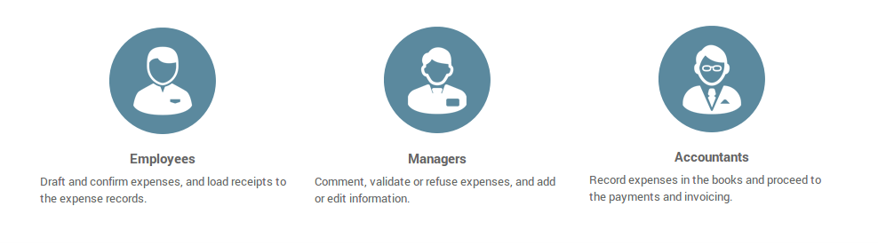
Expense Management
A full overview of employee expenses, streamline the approval process and track all records.
Record and access all employees’ fees, travel expenses or any other costs.
Allow employees to add copies of the receipts and proofs directly
Manage expenses per team
CC-BY-NC-SA

Slide 40



Integration with other Odoo Apps
Employee Profile
Oversee employee records and easily maintain files and information for your teams.
Expenses
Expenses records and receipts

Slide 41
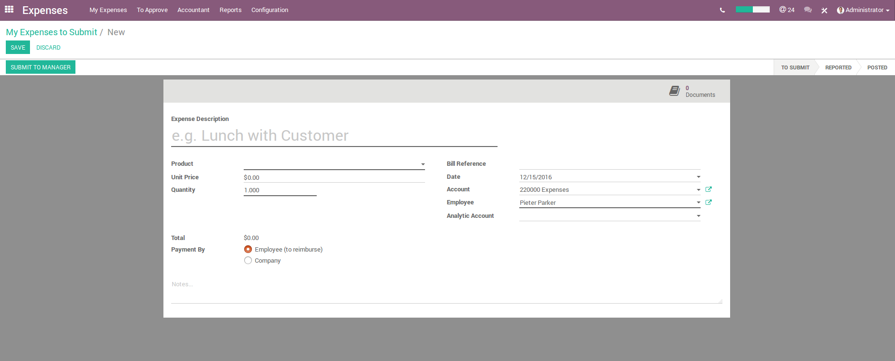
Record expenses
CC-BY-NC-SA

Slide 42
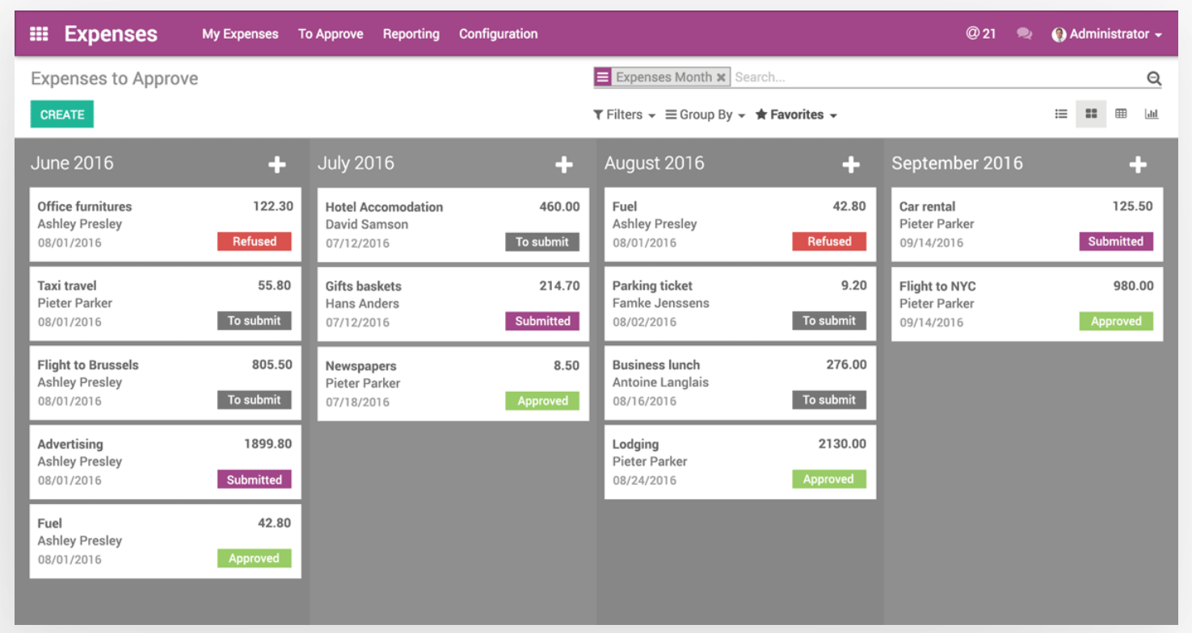
Streamlined expense management
CC-BY-NC-SA

Slide 43
Exercise : Employee profile / Timesheets / Leaves
30 min
All Directors of « Canadian Colors Inc » participated in the Annual National Congress of Decoration which carried out in the Unit States in the city of Chicago. The participants of this activity executed the following expenses :
TO DO
Create the new employee profile as director for this company. Invent the information that is necessary.
Record all expenses for this employee
Create and link all expenses to « Annual National Congress of Decorarion - Chicago » as Analytical Account.
CC-BY-NC-SA

Slide 44
Fleet Management

Slide 45
Fleet Management
Track company vehicles, mileage logs, maintenance schedules, contracts and more with clean and organized fleet management.
Organize the services around the vehicles and communicate with the qualified service providers, manage invoices and notes.
Monitor all costs for each of the fleet vehicles.
CC-BY-NC-SA

Slide 46


Integration with other Odoo Apps
Fleet
Vehicule, leasing insurance, costs
CC-BY-NC-SA

Slide 47
Questions?
CC-BY-NC-SA

Slide 48
Contributions
This document has been authored and distributed by the functional team of Odoo, Savoir-faire Linux :
Carolandrea Guerrero
Mickaël Brard
Marc Lijour
Julien Jézéquel-Bréard
Bruno Joliveau
Quentin Lavallée
Adriana Ierfino
Guillaume Lot
You can download this training document, use and modify it (within diposals and limits of the applicable licence CC-BY-NC-SA), at the following url : https://github.com/savoirfairelinux/training-odoo

Slide 49

IT Management Solutions

